Slide 1

The Art of Making Students More Employable with
Webinar by Rob Jenkins
Notes:
Thank you for coming to our webinar. I am so excited to share some ideas that you will be able to use in the classroom immediately.

Slide 2
Basic
Book 1
Book 2
Stand Out:
6 Level Series
Book 3
Book 4
Book 5
Print Workbooks
Promotes recycling
Multilevel Worksheets
Promotes customization and recycling
Online Workbook
Promotes digital literacy and recycling
Notes:
This workshop is designed for anyone interested in Stand Out and developing their students’ employability skills. There is a lot to cover in 1 hour so let’s get right to it.

Slide 3
Today’s Goals and Objectives
Identify what we mean when we say “employability skills”.
Identify classroom techniques to help students learn these important skills.
Find those techniques in Stand Out.
For philosophy documents and a short history of employability instruction in Adult Education, go to ESL-Teacher.net
Notes:
The best way to get most out of Stand Out is to understand where we as authors are coming from! There is so much to consider anymore when you walk into the classroom. It can be overwhelming when we are bombarded by standards and new teaching methods. How do we interpret those standards? What do they really mean in the classroom. That is really the purpose of this webinar. We will talk specifically about employability in this webinar.

Slide 4
History of Employability Skills in Adult Education
1992: SCANS
2000: EFF
2002: 21st Century Skills
2013: CCR Standards
Recently: Employability Skills Framework
For a short history of employability instruction in Adult Education, go to
ESL-Teacher.net

Slide 5
History of Employability Skills in Adult Education from the beginning to today.
SCANS | Employability Skills Framework
Basic Skills Thinking Skills Technology Interpersonal Skills Systems Personal Qualities Information Resources | Communication Skills Critical Thinking Skills Technology Use Interpersonal Skills Systems Thinking Personal Qualities Information Use Resource Management Applied Academic Skills
Notes:
Notice how SCANS and the Newer Employability Framework compare.

Slide 6
What kind of activities would you expect to see to promote soft skills? (Chat)
Combine ideas and information
Make decisions and solve problems
Exercise leadership roles
Manage money
Manage time
Complete tasks as assigned
Interact appropriately with team members
Collect and organize information
Interpret and communicate information
Apply technology to a task
Perform basic computations
An excellent assessment tool can be found at http://www.newwaystowork.org/qwbl/tools/kcktoolkit/Tools/Tool_20.PDF
Notes:
Here are a few “Soft Skills” that we ask students to do so they are more prepared for the workplace. Type into the chat pod others you might consider. After 1 minute, click.

Slide 7
REAL Critical Thinking Guiding Principle (Chat)
“Tasks that require learners to think deeper than the superficial vocabulary and meaning”
Jenkins & Johnson 2016
Notes:
First ask what is Critical thinking. Write a guiding principle. This is the guiding principle we used to write our materials and the guiding principle I use every day in my classroom.

Slide 8
Examples of Critical Thinking Activities that promote Employability
analyzing data (graphs, charts)
classifying
collaborating over a problem
comparing (VENN, Johari, charts)
defining concepts
evaluating information with a rubric
individually solving problems
predicting outcomes
ranking
reaching consensus
Notes:
Here are some activities we routinely do in Stand Out.

Slide 9
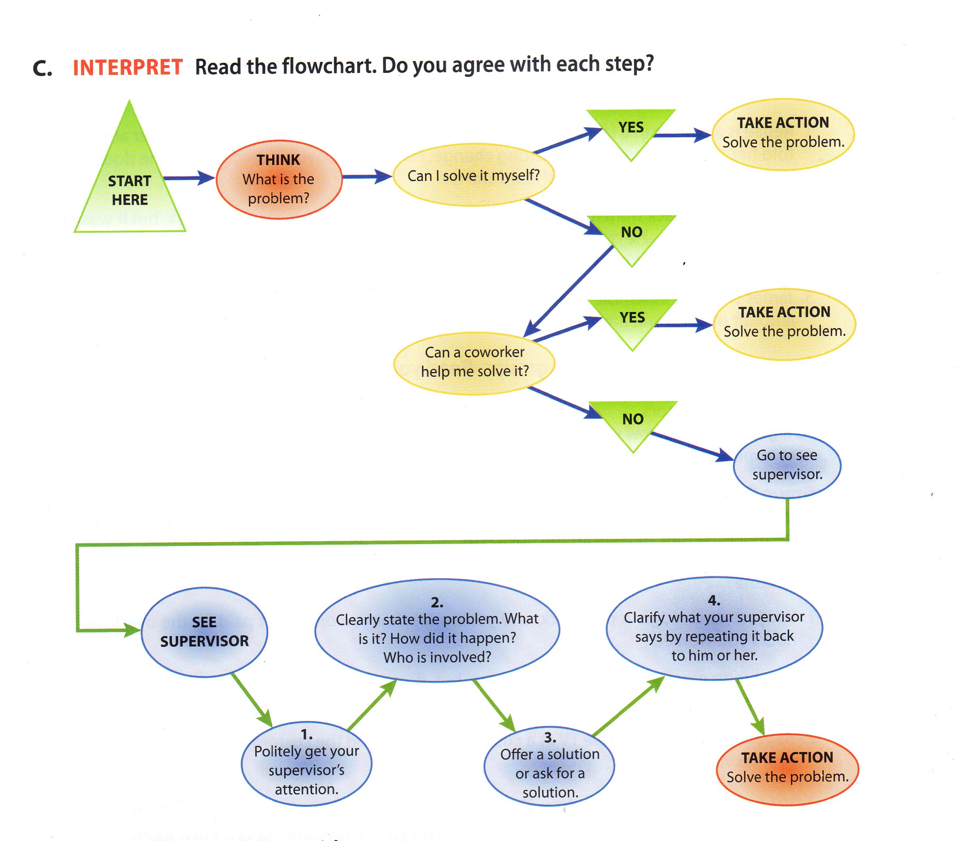
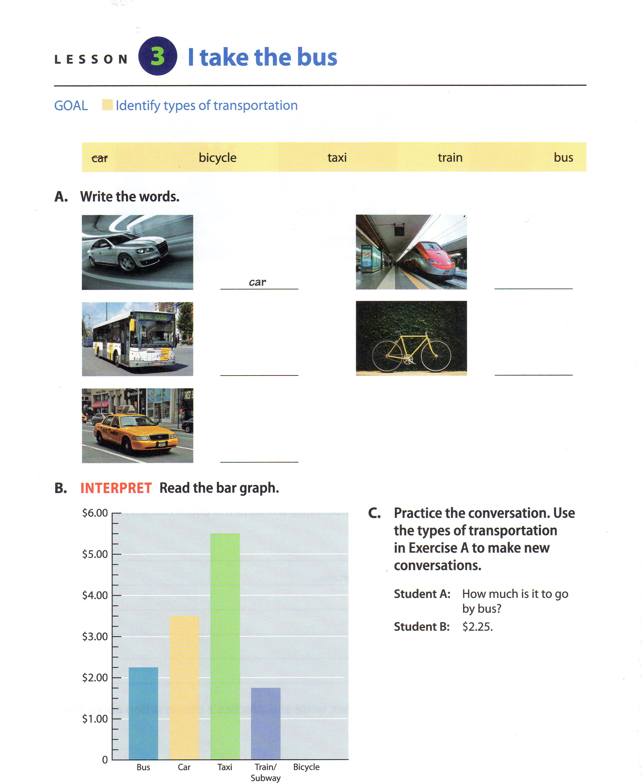
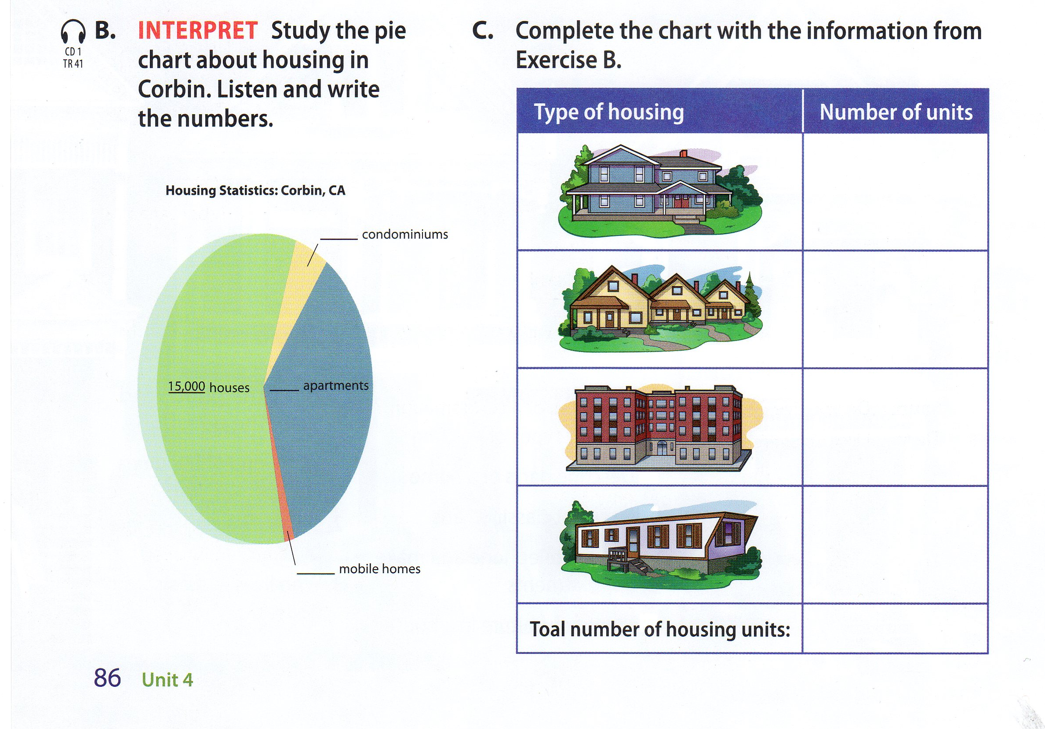
Graphs & Charts
Book 4
Book Basic
Book 1
Notes:
So here are examples

Slide 10
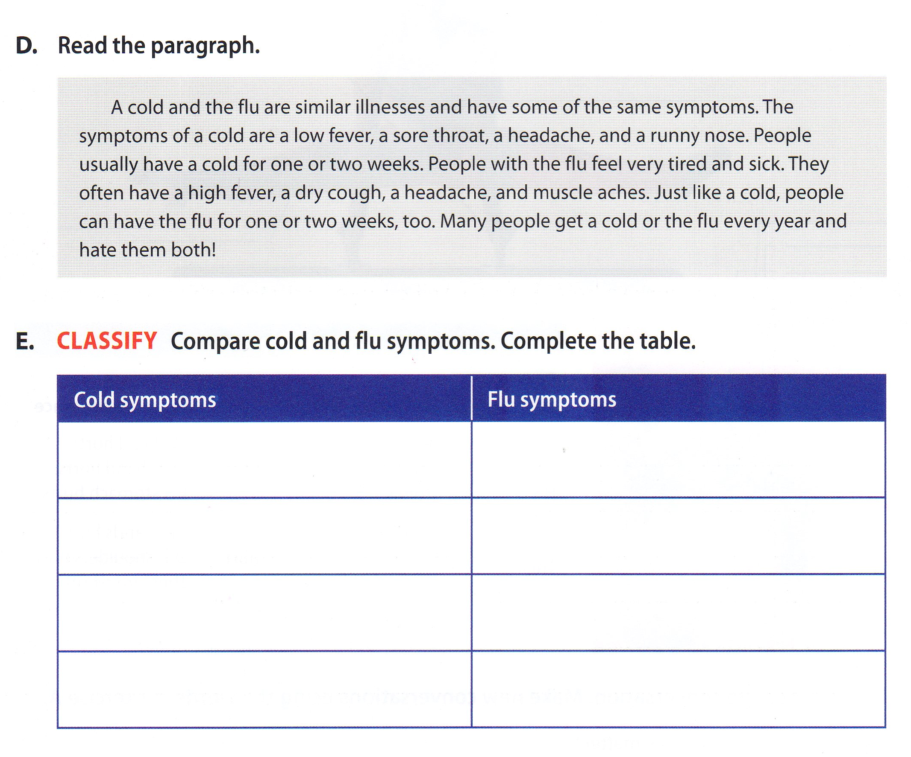
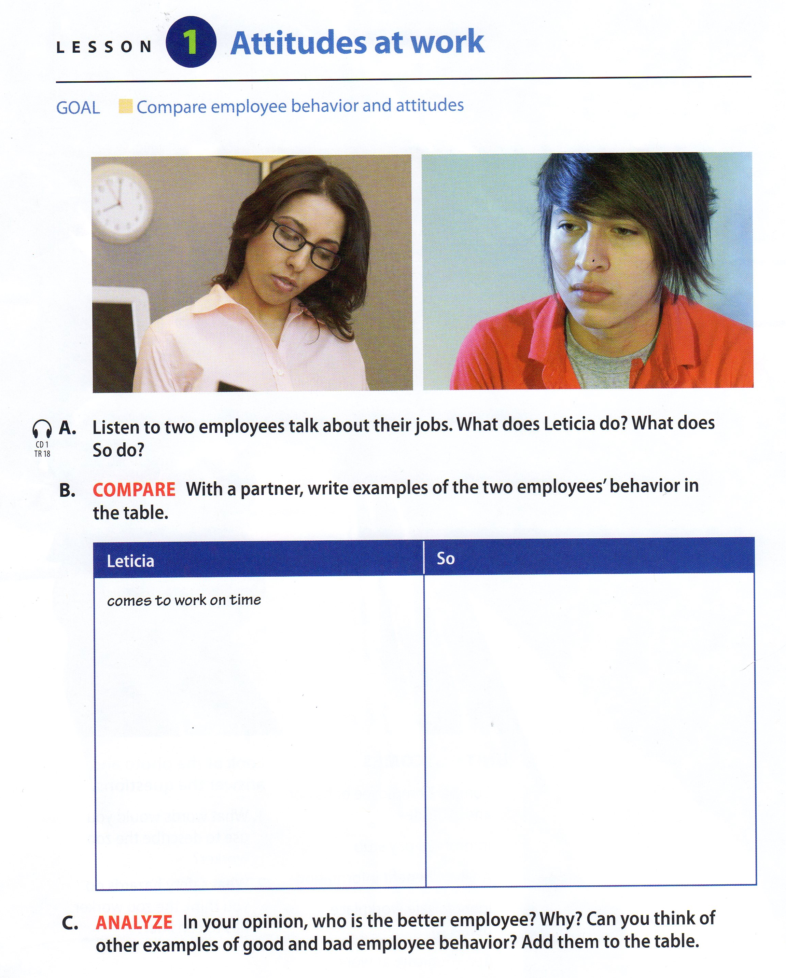
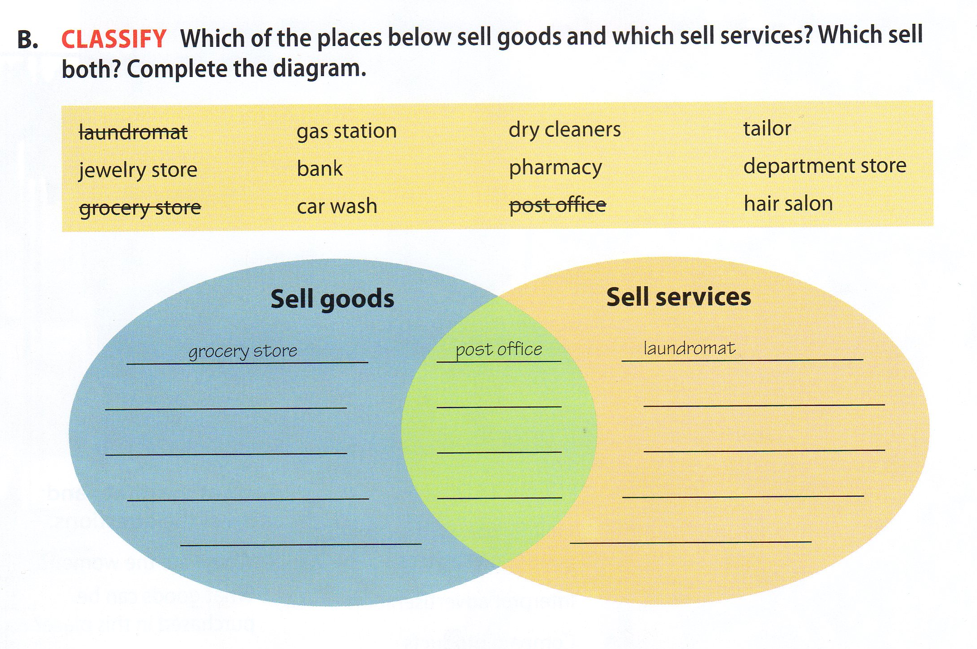
Compare
Book 2
Book 3
Book 3
Notes:
So, here is an example.

Slide 11
What do employability activities look like beyond basic communication?
When calculations are involved
Perform basic computations.
When a conclusion is required
Make decisions & solve problems
When technology can be used
Apply technology to a task
Applications that ask to create
Combine ideas and information
Any task that involves money
Manage money
When students have to think beyond superficial meaning
Critical Thinking

Slide 12
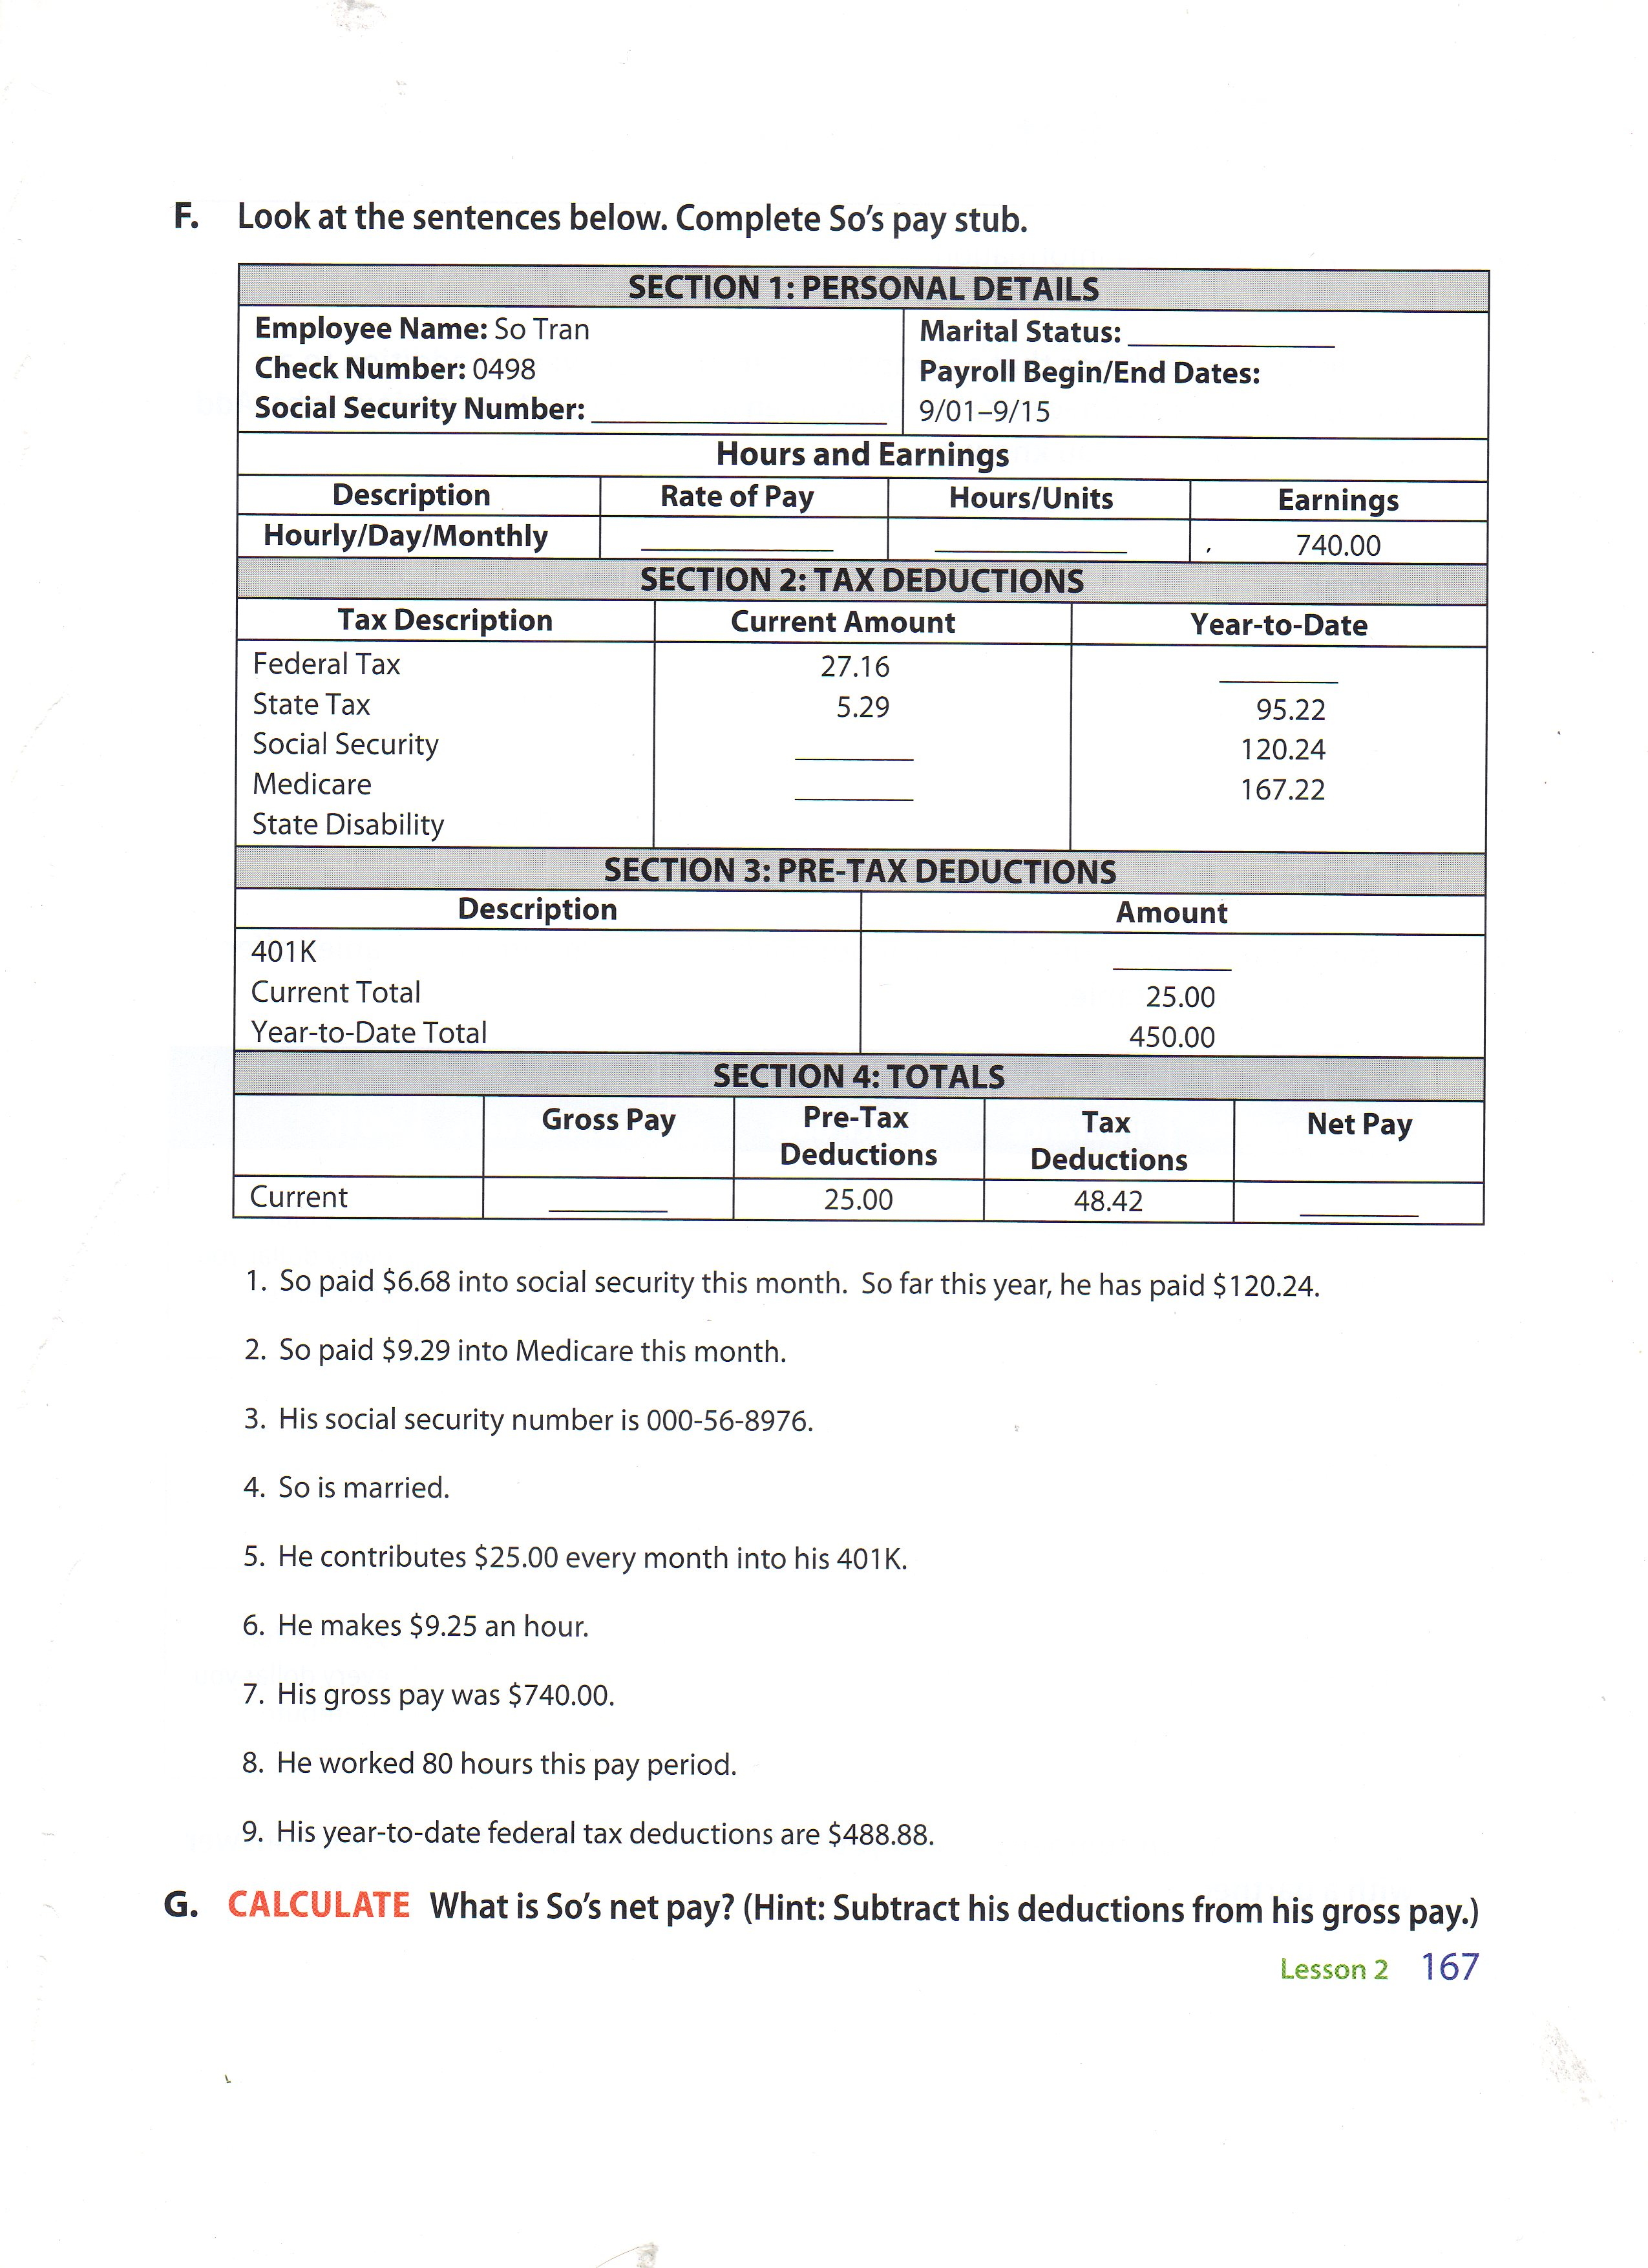
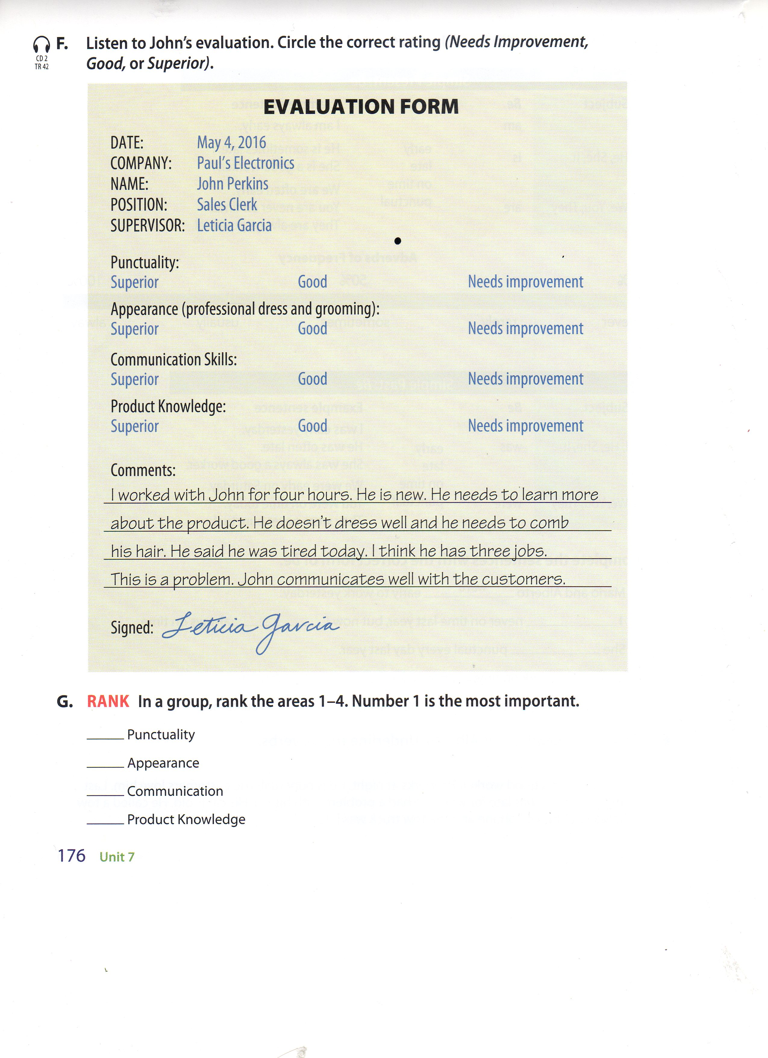
Standard Workplace
Book 3
Book 1
Notes:
ESL Adult Education Books always have the standard units on “workplace”.

Slide 13
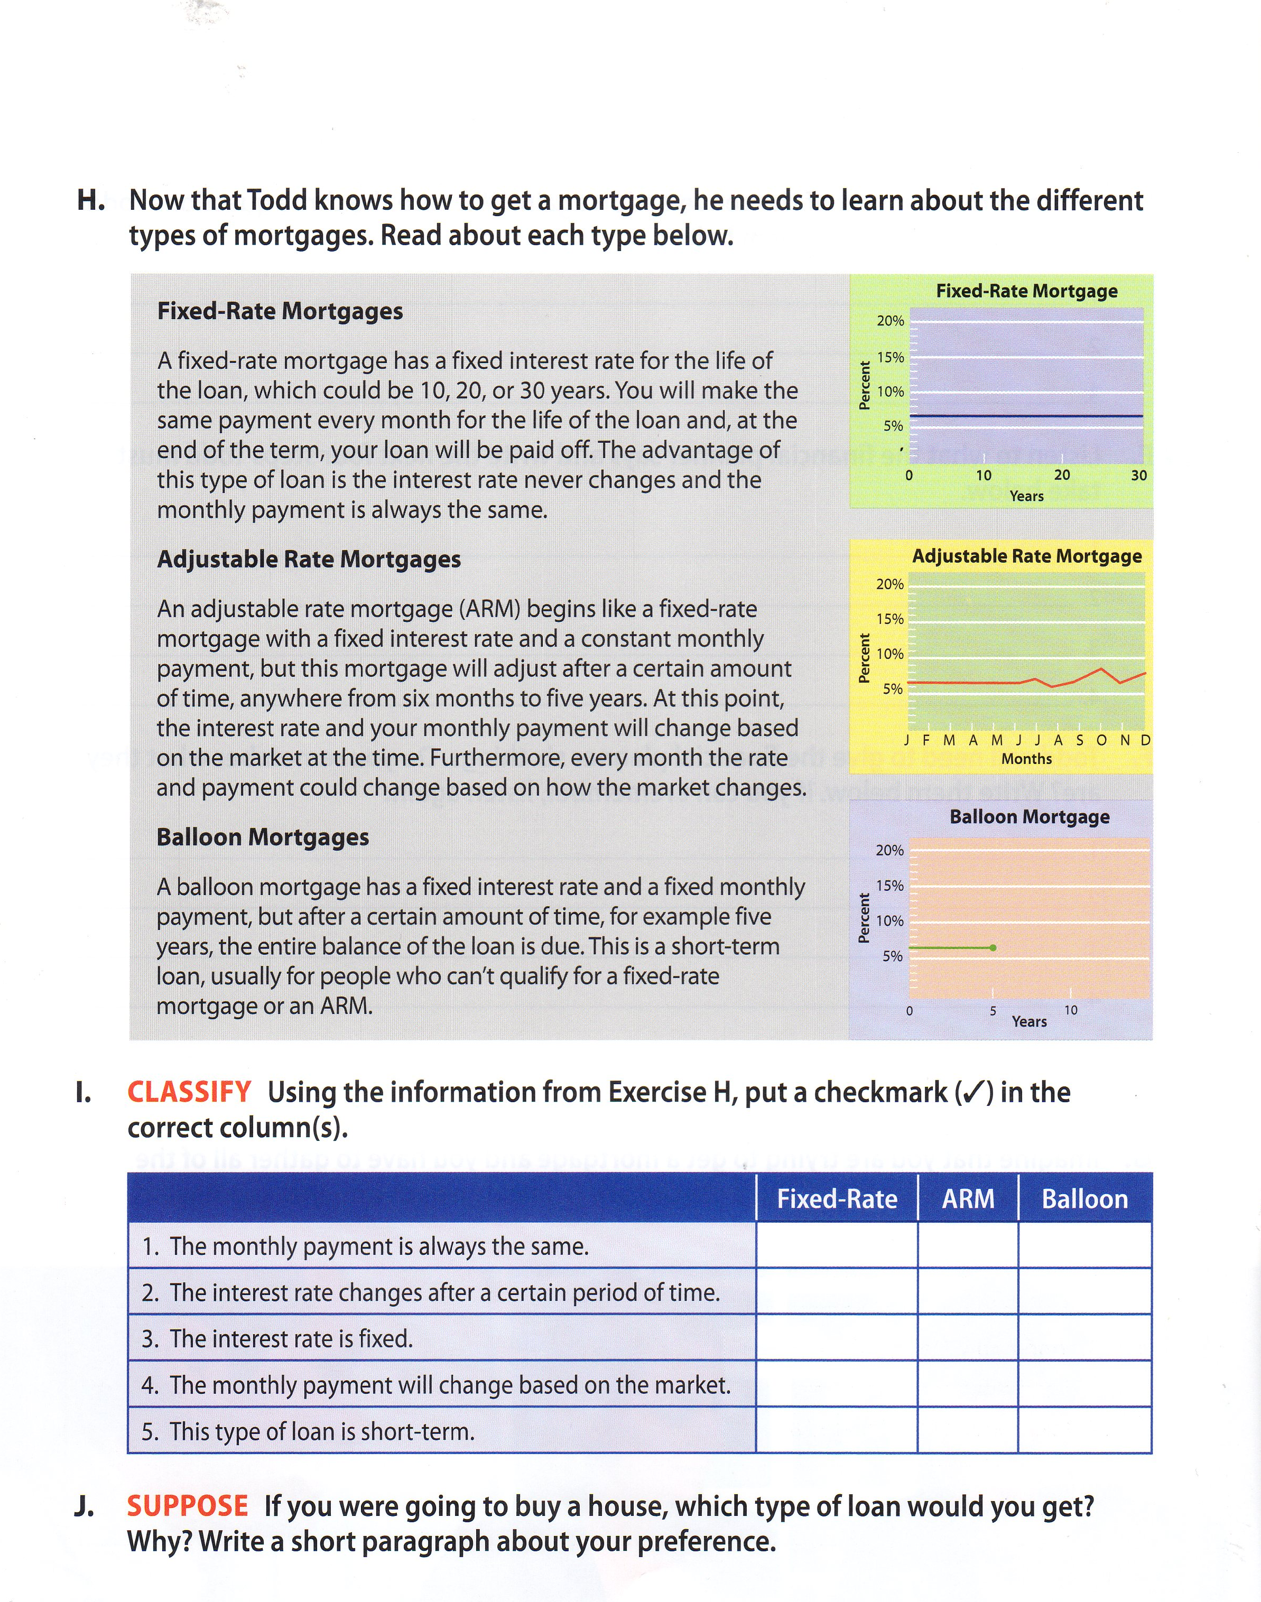
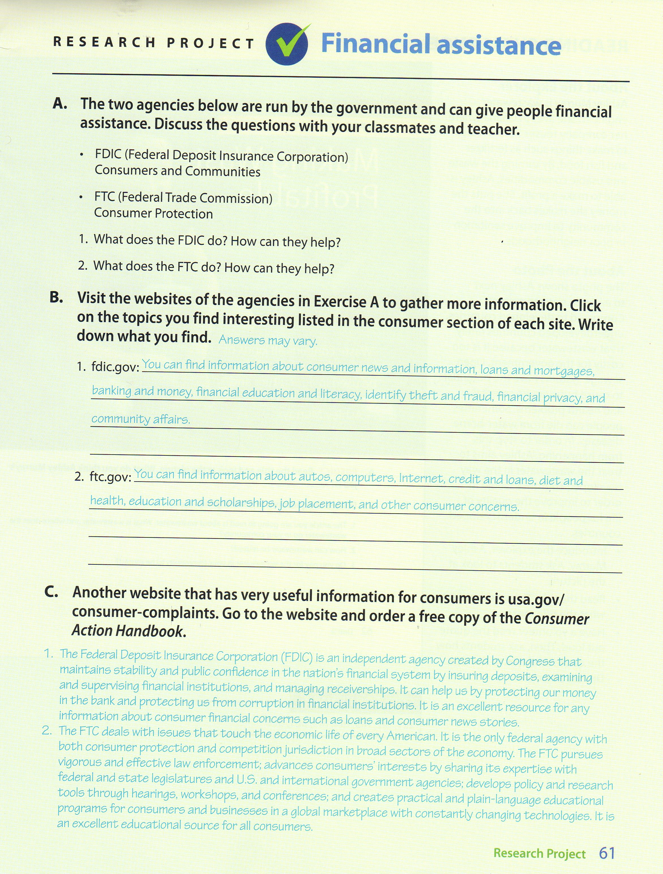
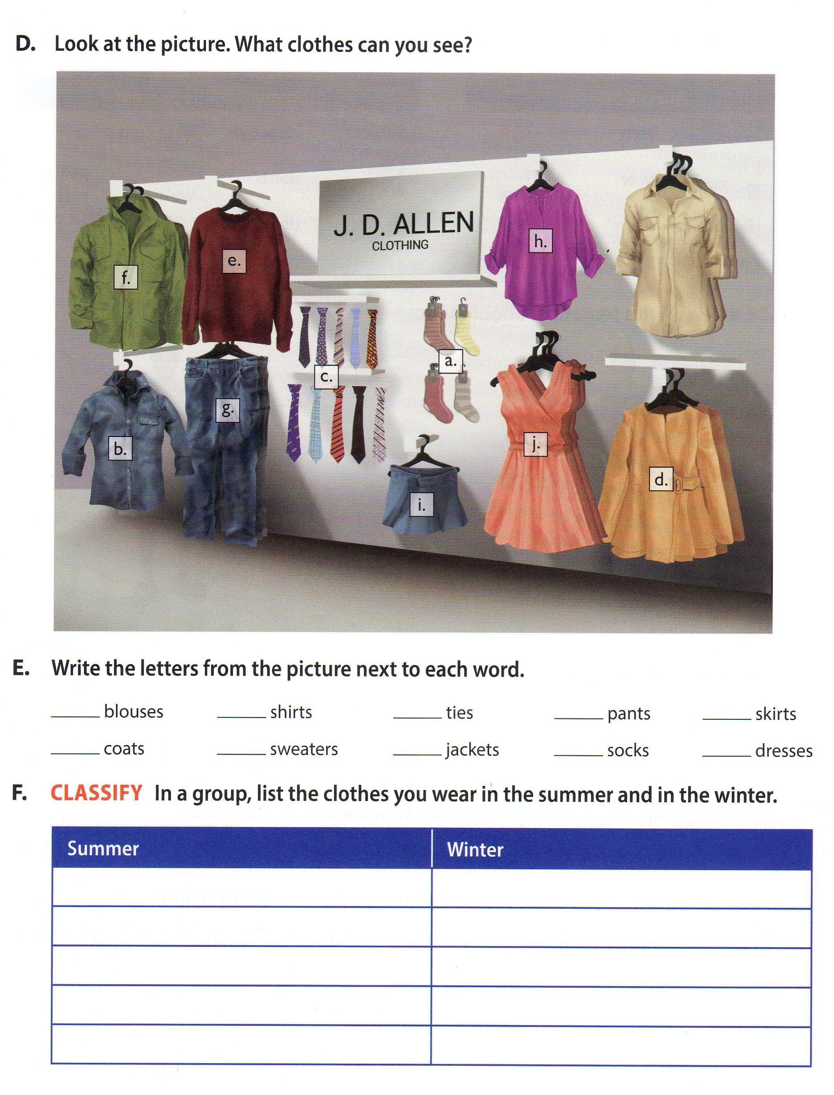
Collecting and Organizing Information
Book 5
Book 2
Book 4
Notes:
Here are examples of other “employability activities”. All employability activities are highlighted in the Lesson Planner.

Slide 14
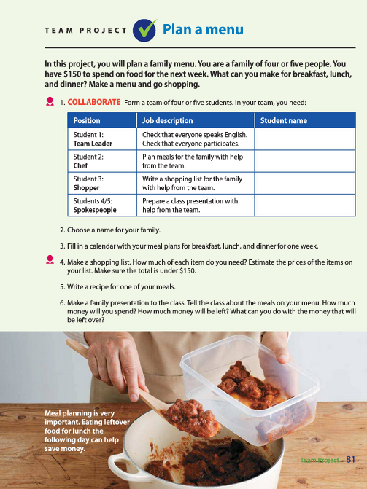
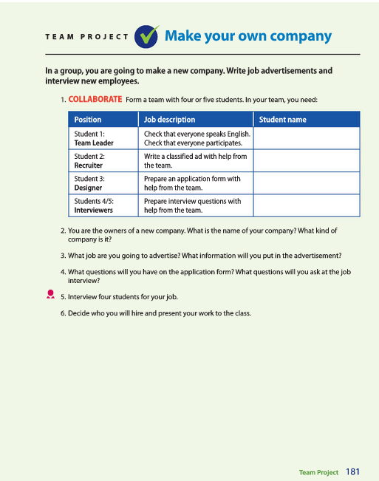
Project-Based Learning (PBL)
Notes:
We also have the ultimate in workplace and critical thinking. Projects are also ideal for EL Civics applications.

Slide 15
Team Projects
Basic | Book 1 | Book 2 | Book 3 | Book 4 | Book 5
Make a class book | Create a student profile | Describe a student | Make a schedule | Create a goal chart | Create a personal profile
Make a display (culture) | Plan a department store | Design a clothing store | Create a purchase plan | Purchase plan | Create a financial plan
Make a shopping list | Create a restaurant | Plan a menu for a week | Create a housing plan | Real estate brochure | Create an auto handbook
Open a clothing store | Plan a dream home | Plan a move | Create a city brochure | Community Resource Guide | Housing issues Presentation
Describe your community | Make a city brochure | Describe your community | Create a healthy living plan | Community health pamphlet | Health Presentation
Create an appointment book | Role-play an emergency | Make a health pamphlet | Create a job app portfolio | Job application portfolio | Create an online store
Start a company | Get a new job | Make your own company | Create employee handbook | Solve a company problem | Set-up a business office
Create a study guide | Meet your goals | Make a time line | Run for mayor | Conduct an election | Give an opinion speech
Notes:
Look at these!

Slide 16

Workplace Connection
Combine ideas and information
Make decisions
Exercise leadership roles
Manage time
Complete tasks as assigned
Interact appropriately with team members
Collect and gather information
Interpret and communicate information
Apply technology
See Lesson Planner for Annotations
Notes:
Here are examples of workplace activities we use in Stand Out. You will find these in the Lesson Planner.

Slide 17
Team Projects - Samples
Company Name:
Company Makes or Does:
Job Title | Hours | Pay | Benefits | How Long
Paragraph about your company:
Notes:
Look at these!

Slide 18
Team Projects - Samples
Answer the questions about your new town or city.
Make a list of places in your city.
What’s the name of your city.
How many people live in your city.
Is your city large or small?
What makes your city special?
Write a paragraph about your city.
Notes:
But they don’t have to be on a workplace theme to promote employability. Look at this one. First students are asked to gather information. Then…

Slide 19

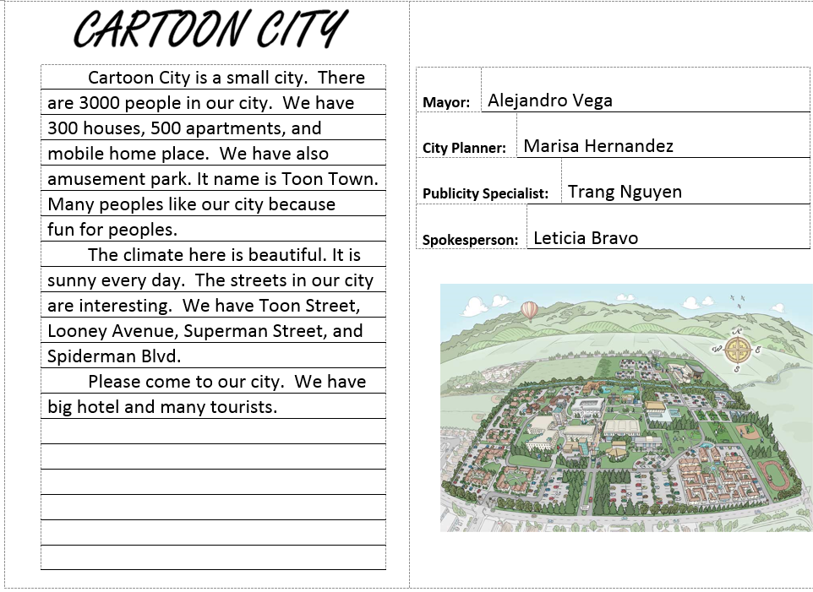
Team Projects - Samples
CARTOON CITY
Notes:
Continued from last slide.

Slide 20
What did we learn?
Identify what we mean when we say “employability skills”.
Identify classroom techniques to help students learn these important skills.
Find those techniques in Stand Out.
For philosophy documents and a short history of employability instruction in Adult Education, go to ESL-Teacher.net
Notes:
The best way to get most out of Stand Out is to understand where we as authors are coming from! There is so much to consider anymore when you walk into the classroom. It can be overwhelming when we are bombarded by standards and new teaching methods. How do we interpret those standards? What do they really mean in the classroom. I hope you have gotten a little out of our discussion today.

Slide 21
Thank You!
Rob Jenkins & Staci Johnson
robjenkins.esl@gmail.com & stacijohnson.esl@gmail.com
ESL-Teacher.net

